Slide 1
Ted talk views prediction

Slide 2
Introduction
TED Talks have become a global phenomenon, offering insightful and thought-provoking presentation.
As the popularity of these talks continues viewership has become an area of interest for both researchers and industry professionals.
involves using data science techniques to estimate the number of views a specific TED Talk will receive. This can be valuable for various reasons

Slide 3
Content Strategy: Understanding which topics and speakers are likely to attract more views can help TED and other platforms tailor their content strategy to meet audience preferences.
Resource Allocation: By predicting viewership, organizations can allocate resources more efficiently, such as scheduling production, marketing, and promotion.

Slide 4
Analyzing factors that influence viewership can help identify ways to increase audience engagement and retention.
Sentiment analysis of viewer comments can provide insights into audience reactions and engagement.
Video length can influence viewership, with shorter talks often being more popular.

Slide 5
Publication date and time of day can impact viewership patterns.
Cross-promotion with other TED Talks or content can increase visibility.
Geographic location can influence viewership, as different regions may have varying interests.

Slide 6
Linear Regression
that the relationship can be represented by a straight line.
Is a statistical method used to model the relationship between a dependent variable and one or more independent variables. It assumes a linear relationship between the variables, meaning that the relation ship can be represented by a straight line.

Slide 7
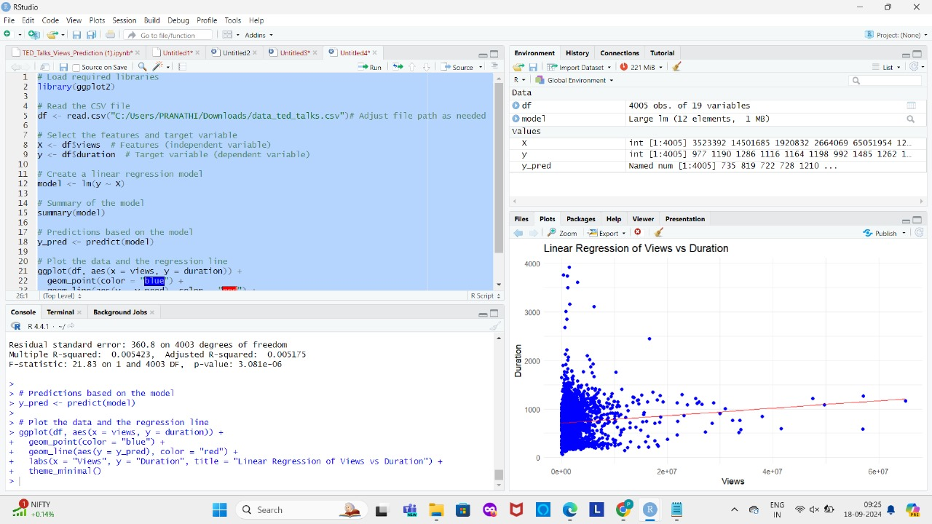
rr

Slide 8
Dependent variable.
Independent variable.
Regression variable.
Simple Linear Regression: When there is only one independent variable,its called simple linear regression.
Y=mx+b
y;dependent varabile.
m; slope
b is the y-intercept
X;independent variable
,

Slide 9
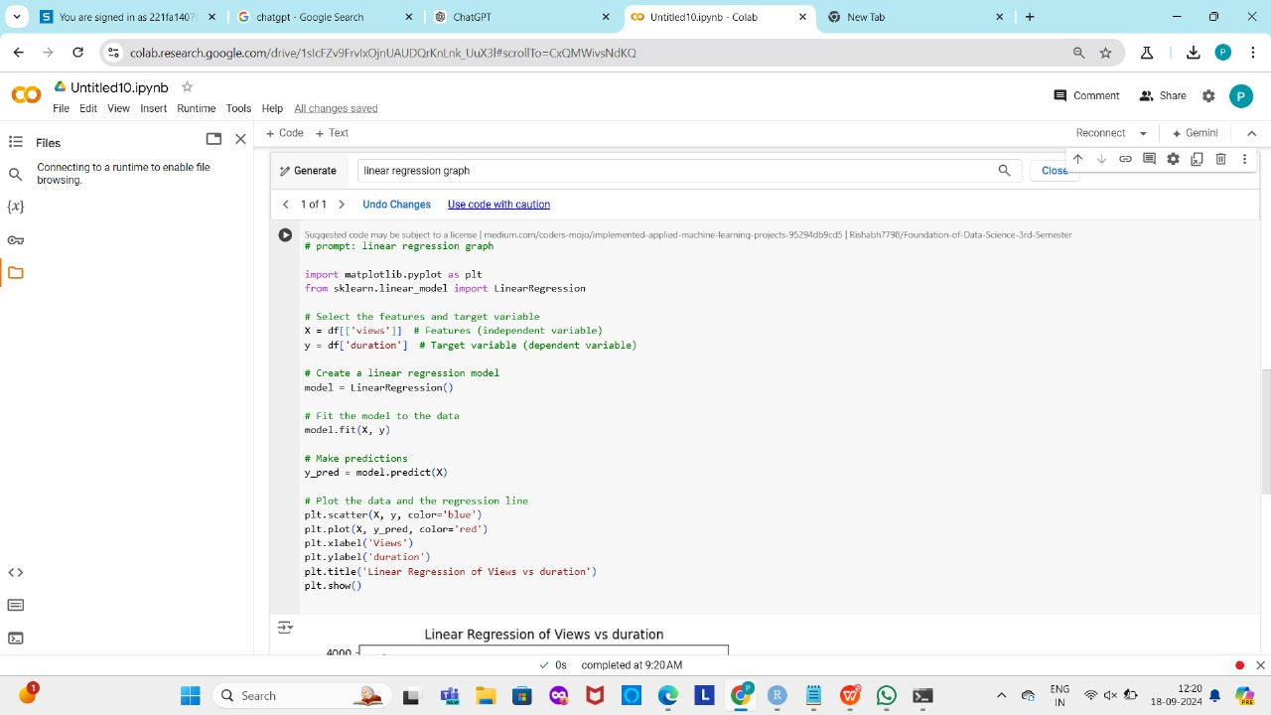
rr

